Slide 1
Full Stack Development
Gurupriya M

Slide 2
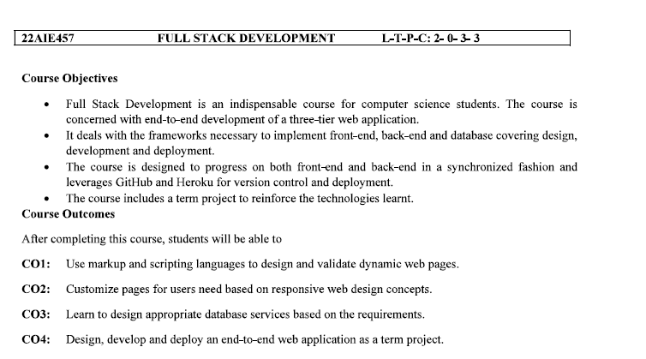

Slide 3
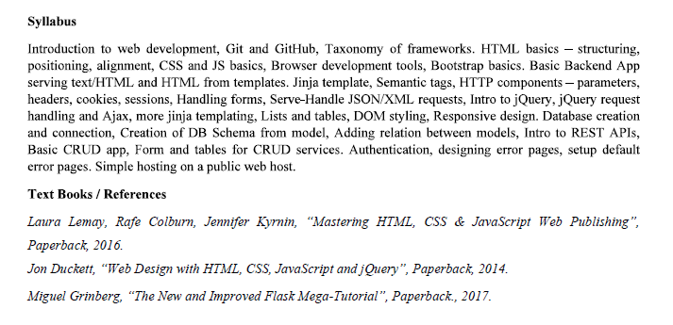

Slide 4
Full Stack Development
A full-stack web development framework provides complete front-end (client-side) and back-end (server-side) development support. It provides a comprehensive set of tools and libraries to handle all aspects of web application development, from the presentation layer (HTML, CSS, and JavaScript) to the database layer (storage and retrieval of data).

Slide 5
Front end development
Page with UI components with navigation and utility –eg Login page
Front end is a visible part of the website or web application
The user interacts directly with the front end portion of the website / web application

Slide 6
Frontend Languages
It defines the structure of websites and formats the webpages.
Eg
HTML
CSS
JS

Slide 7
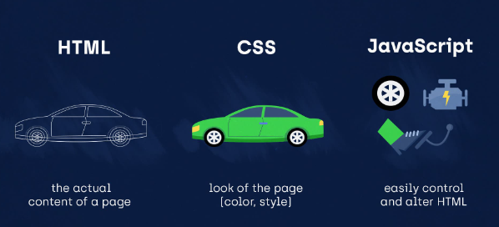

Slide 8
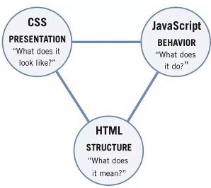
Main Components

Slide 9
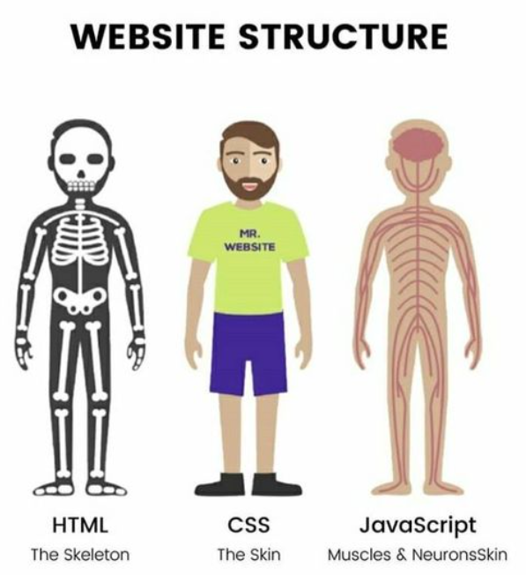

Slide 10
HTML - Hyper Text Markup Language
A markup language is a set of markup tags.
HTML documents are described by HTML tags.
Each HTML tag describes different document content.
HTML defines the basic structure and the contents of a website.

Slide 11
CSS- Cascading Style Sheets
CSS was first developed in 1997, as a way for Web developers to define the look and feel of their Web pages.
It was intended to allow developers to separate content from design so that HTML could perform more of the function that it was originally based on – the markup of content, without worry about the design and layout.

Slide 12
JS- Java Script
JavaScript is the most popular programming language in the world, used to make web pages interactive.
JavaScript is not a programming language in strict sense, is most commonly used as a client side scripting language, that is, a lightweight programming language that is interpreted by the browser engine when the web page is loaded
Makes the web page interactive and brings web application to life.

Slide 13
Backend Development
Backend refers to server-side development of the application
Responsible to manage database using Queries and APIs , retrieves data from the DB and presents to user
Includes Data Consistency

Slide 14
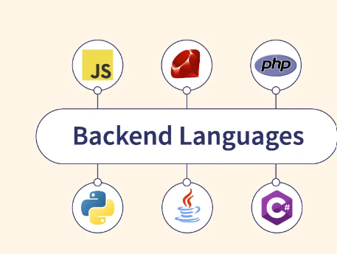
Backend languages

Slide 15
DBMS
DB systems provide the space for easy addition, retrieval and deletion of data from the database and organizes the data in the form tables, views, Schemas and reports

Slide 16
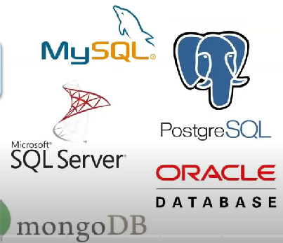

Commonly used Databases

Slide 17
Web Development Frameworks

Slide 18
Web development frameworks are groups of libraries and tools that make it easier for developers to create and maintain web applications efficiently. They offer a framework for creating and managing websites and web applications, accelerating and simplifying development.
Developers can use the top web development frameworks to build dynamic, browser-compatible websites and web apps to provide a seamless digital experience.

Slide 19
Web Development Framework
A web development framework is a pre-written set of software tools, libraries, and guidelines designed to make web application development faster, easier, and more efficient.
It provides a standardized structure and rules for building web applications, saving developers time and effort by handling everyday and repetitive tasks, such as routing, database interaction, session management, and authentication.

Slide 20
Web development frameworks are available for front-end and back-end development that support a wide range of features and functions, including UI components, data binding, server-side processing, and content management.
They are accessible in several programming languages. Developers have a variety of web development frameworks to choose from depending on their project’s particular needs.

Slide 21
Benefits of using Web Development Frameworks
Speed and Efficiency: build applications faster and with less code.
Consistency and Modularity: maintains consistency with modules
Security: built-in security features - protects against threats.
Community Support: Supports large communities of developers who provide support and resources.
Scalability: scaling of applications
Testing and Debugging: tools and features - testing and debugging easier.

Slide 22
Types of Web Development Frameworks
Front-end web development frameworks
Back-end web development frameworks
Notes:
simplifies the process of building web applications by providing tools and pre-written code for each specific layer of the application.

Slide 23
Front end frameworks
Front-end frameworks are focused on the presentation layer of a web application and are responsible for rendering the user interface.

Slide 24
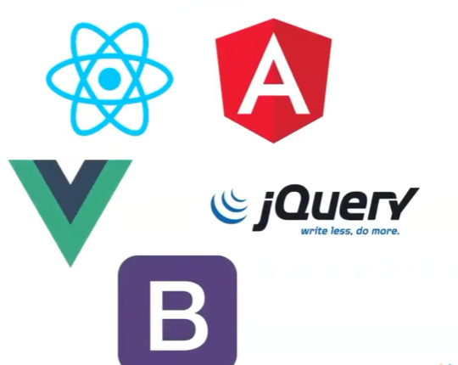
Frontend Frameworks and Libraries
Javascript frameworks and libraries
Help to develop front end application
React, Angular, Vue.js, Jquery, Bootstrap

Slide 25
Back-end frameworks
Back-end frameworks are focused on an application’s server-side functionality.
They provide the tools and structure necessary to build the application’s backend, including database interaction, server-side rendering, and API development.
Notes:
Both web development frameworks can significantly improve the development process by providing a set of conventions and tools to streamline the creation of complex applications. However, it is essential to choose the proper web development framework for the specific needs of a project, as some frameworks may be more suitable for certain types of applications or development teams.

Slide 26
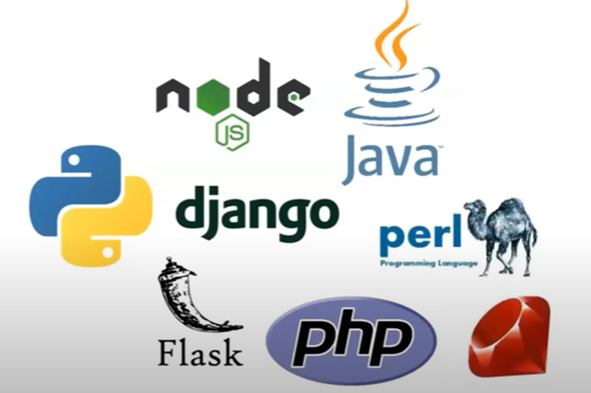


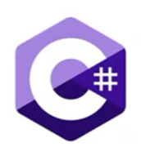
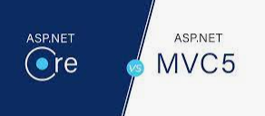
Backend Languages and framework
Notes:
Java Provides spring and Java server faces, C# ASP.core and ASP.MVC

Slide 27
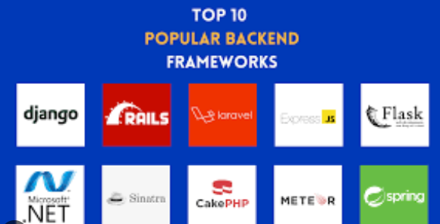
2023
Notes:
Sinatra
Framework on ruby
Meteor on JS

Slide 28
Differences
FRONT-END FRAMEWORKS | BACK-END FRAMEWORKS
Focus on the client-side components of a web application, including the user interface and user experience. | Focus on the server-side components of a web application, including handling requests, managing databases, and processing data.
Provide pre-written tools and libraries for building interactive and responsive user interfaces like buttons, forms, and data visualization components. | Provide pre-written tools and libraries for building scalable and secure server-side applications, such as routing, authentication, and database integration.
Typically use a variety of programming languages, such as HTML, CSS, and JavaScript. | Typically use a variety of programming languages, such as Ruby, Python, and Java.
Handle tasks such as data binding, state management, and routing within the user's browser. | Handle tasks such as authentication, database interaction, and security within the server.
Examples of front-end frameworks include React, AngularJS, and Vue.js, Svelte, react, Ember.js, Lit, Alpine. Js, ASP.NET Core, jQuery, Semantic UI, Foundation, Backbone.js, Knockout.js, Tailwind CSS | Examples of back-end frameworks include Ruby on Rails, Django, and Express, Gatsby, Nuxt, Koa.js, Nest.js, Meteor, Hapi, Ruby on Rails, Laravel, Pheonix, Flask, CakePHP

Slide 29
Web Framework Architecture
Developing a web application by applying a software architecture pattern is always preferred by developers. An architecture pattern gives modularity to the project files and assures that all the codes get covered in Unit testing. It makes the task easy for developers to maintain the software and to expand the features of the application in the future
Software Design Patterns

Slide 30
Three- Tier Architecture
Presentation tier ( the user interface)
Application tier ( business logic)
Database tier (data storage and retrieval)
Notes:
The presentation tier handles the user interface, the application tier handles the business logic, and the database tier handles data storage and retrieval.

Slide 31
Three-tier architecture is a well-established software application architecture that organizes applications into three logical and physical computing tiers: the presentation tier, or user interface; the application tier, where data is processed; and the data tier, where the data associated with the application is stored and managed.
The chief benefit of three-tier architecture is that because each tier runs on its own infrastructure, each tier can be developed simultaneously by a separate development team, and can be updated or scaled as needed without impacting the other tiers.

Slide 32
Web Framework Architecture/ pattern
MVC Architecture ( Model – View – Controller)
MVP Architecture (Model—View—Presenter)
MVVM Architecture ( Model — View — ViewModel)
MVT Architecture(Model- View – Template)

Slide 33
Model-View-Controller (MVC) Architecture
3 components
Model (data)
View (user interface)
Controller (user input and business logic)
Eg Frameworks using this architecture:
Ruby on Rails, Laravel, Spring, Django, and ASP.NET.
Notes:
Application is divided into 3 components
The model represents the data, the view represents the user interface, and the controller handles user input and business logic. This separation makes the application easier to develop, maintain, and test. Many web development frameworks are built using this architecture, and here are some popular examples: Ruby on Rails, Laravel, Spring, Django, and ASP.NET.

Slide 34
In Detail
Model: This component stores the application data. It has no knowledge about the interface. The model is responsible for handling the domain logic(real-world business rules) and communication with the database and network layers.
View: It is the UI(User Interface) layer that holds components that are visible on the screen. Moreover, it provides the visualization of the data stored in the Model and offers interaction to the user.
Controller: This component establishes the relationship between the View and the Model. It contains the core application logic and gets informed of the user’s response and updates the Model as per the need

Slide 35
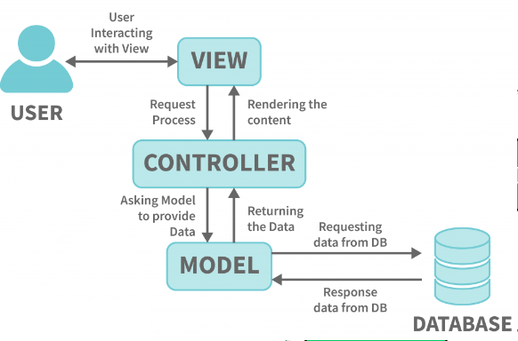
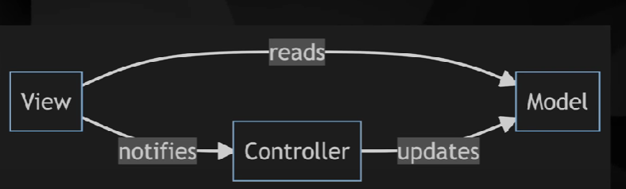
MVC pattern
Notes:
If model is changed, view have to be changed.. But in MVP – if model is changed, presenter will make the changes in view and view need not worry.

Slide 36
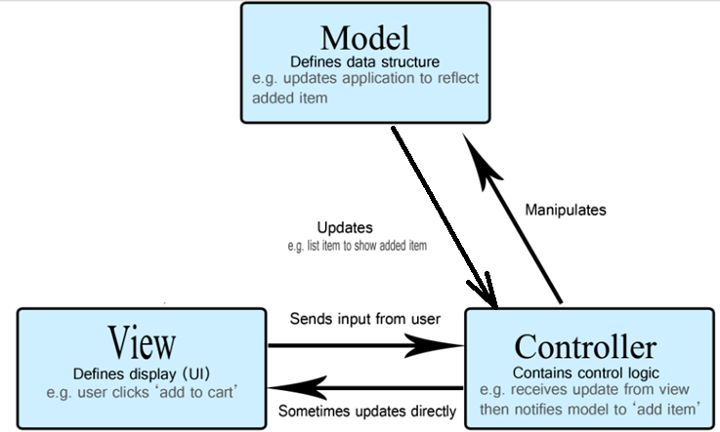
For e.g. Add an item to cart

Slide 37
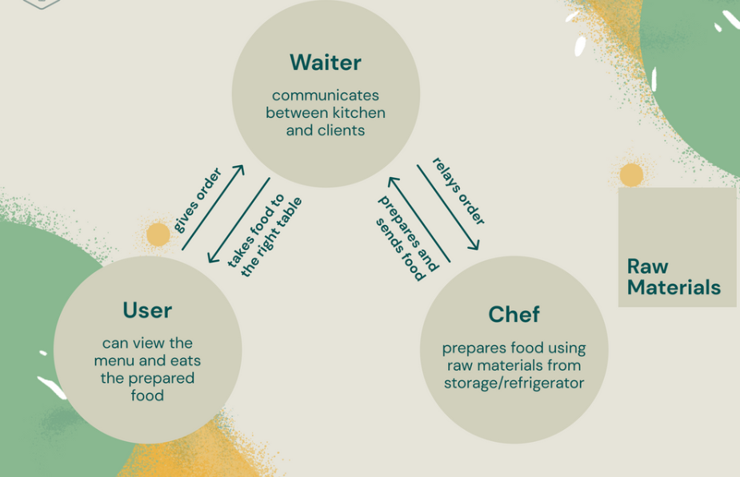
Another Simple eg for MVC architecture

Slide 38
Generally
In a webpage data model is probably contained in some kind of database (be it a traditional server-side database or a client-side solution )
app's controlling code is probably written in HTML/JavaScript,
User interface is probably written using HTML/CSS/whatever else you like.
This sounds very much like MVC, but MVC makes these components follow a more rigid pattern.

Slide 39
In the early days of the Web, MVC architecture was mostly implemented on the server-side, with the client requesting updates via forms or links, and receiving updated views back to display in the browser.
However, these days, more of the logic is pushed to the client with the advent of client-side data stores, and XML HttpRequest allowing partial page updates as required.

Slide 40
MVP architecture
Model-View-Presenter (MVP) which is a derivation of the Model-View-Controller (MVC) pattern.

Slide 41
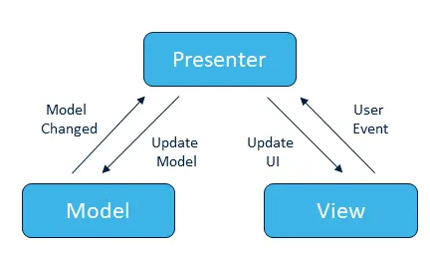
MVP architecture

Slide 42
Benefits of MVP over MVC
Separation of Concerns: Dividing your code into separate parts, each having their own responsibility. This makes the code simpler, more reusable and easier to maintain.
Unit Testing: Since the logic (the presenter) of the UI is separated from the visual layer (the view) it is much easier to test these parts in isolation.
Applications with very complex views and a great deal of user interaction may find that MVC is tougher and needs more multiple controllers. In MVP, all of this complex logic can be encapsulated in a presenter, which can simplify maintenance greatly.

Slide 43
MVP components
The model is an interface defining the data to be displayed or otherwise acted upon in the user interface.
The view is a passive interface that displays data (from the model) and routes user commands (events) to the presenter to act upon that data.
The presenter acts upon the model and the view. It retrieves data from repositories (the model), and formats it for display in the view.
Notes:
If model is changed, view have to be changed.. But in MVP – if model is changed, presenter will make the changes in view and view need not worry.

Slide 44
Model-View-ViewModel (MVVM) Architecture
MVVM architecture (Model-View-ViewModel) is another software design pattern that separates the graphical user interface from the business logic of an application.
Notes:
Many web development frameworks are built using this architecture, and here are some popular examples: AngularJS, Vue.js, Knockout.js, and React.

Slide 45
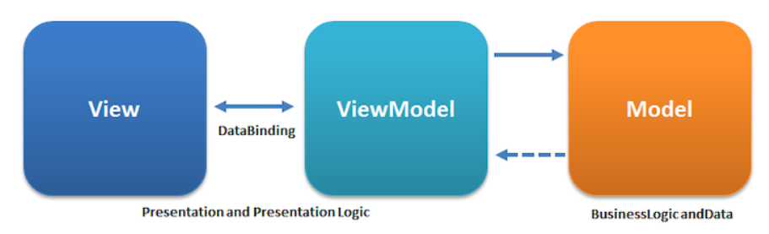

Slide 46
Model-View-ViewModel (MVVM) Architecture
3 components
Model (data)
View (user interface)
View Model(manages the communication between model and view)
E.g. using this architecture : AngularJS, Vue.js, Knockout.js, and React.
Notes:
Many web development frameworks are built using this architecture, and here are some popular examples: AngularJS, Vue.js, Knockout.js, and React.

Slide 47
the View only communicates with the ViewModel and the ViewModel only communicates with the Model.

Slide 48
All user interaction occurs within the View, which is in charge of detecting the user’s input (mouse clicks, keyboard input) and forwarding it to the ViewModel by way of data binding.
Data binding can be implemented with callbacks or properties and constitutes the concrete link between the View and the ViewModel.
The ViewModel implements the properties and commands to which the view can be bound. These properties and commands define the functionality that the View can offer to the user, although how to display it is entirely up to the View.

Slide 49
The Models are classes that model the application’s domain. Models encapsulate the application’s data and business logic. They can be considered business objects that have absolutely no relation to the visual aspect of the application.

Slide 50
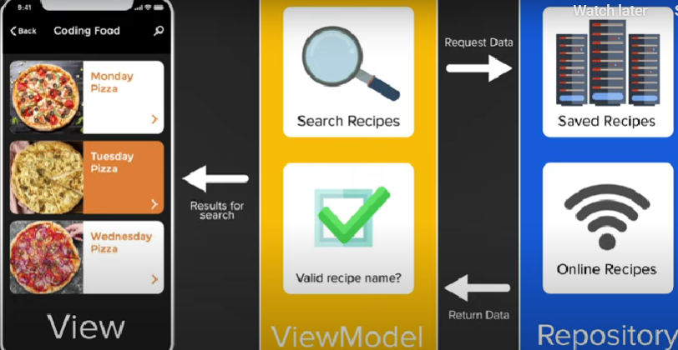
Eg

Slide 51
Benefits of MVVM
Easier to develop: Separating the View from the logic makes it possible to have different teams work on different components simultaneously. A team of designers can focus on the UI while developers work on implementing the logic (ViewModel and Model).
Easier to test: One of the hardest things to test in an application is the user interface (UI). Because the ViewModel and Model are completely independent from the View, developers can write tests for both without having to use the View.
Easier to maintain: The separation between the different components of the application makes the code simpler and cleaner. As a result, the application code is much easier to understand, and therefore, to maintain. It’s easier to understand where we should implement new features and how they connect to the existing pattern. With an MVVM, it’s also easier to implement further architectural patterns (dependency inversion, services and more).

Slide 52
Model View Template (MVT)
This is yet another design pattern similar to MVC. It is also used for implementing web interfaces and applications but in contrast to MVC, the controller part is taken care for us by the framework itself.
It has 3 components and each component has a specific purpose:

Slide 53
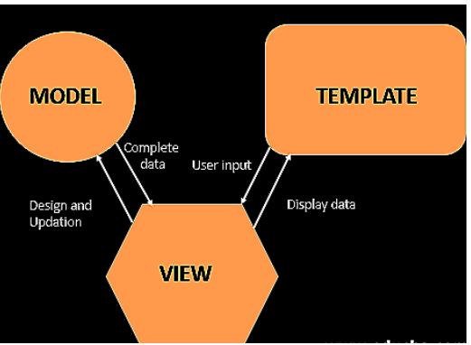

Slide 54
This Model similar to MVC acts as an interface for your data and is basically the logical structure behind the entire web application which is represented by a database such as MySql, PostgreSQL.
The View executes the business logic and interacts with the Model and renders the template. It accepts HTTP request and then return HTTP responses.
The Template is the component which makes MVT different from MVC. Templates act as the presentation layer and are basically the HTML code that renders the data. The content in these files can be either static or dynamic.

Slide 55
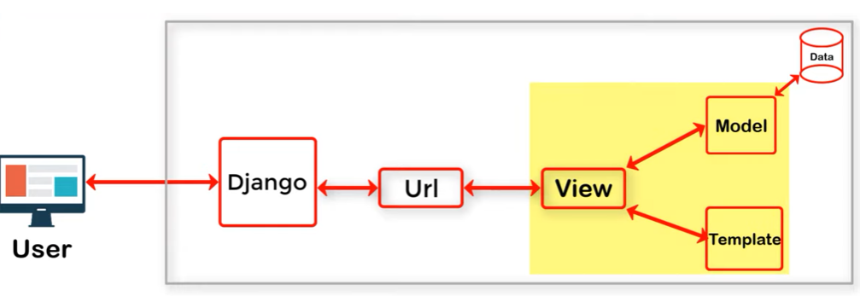

Slide 56
Other terminologies…
Many technologies are available in the market that allow app developers to create feature-rich mobile apps with extravagant characteristics.
That’s when the ‘Stack’ terminology comes into the picture.
And development Stack - two main types - stack of technology and stack of applications.

Slide 57
Application Stack
An application stack is a suite or set of application programs that help in performing a certain task.
These applications are closely linked together and data can be exported or imported among them with minimum steps.
Many office applications include word processing, spreadsheets, databases, and email utilities in one application stack.

Slide 58
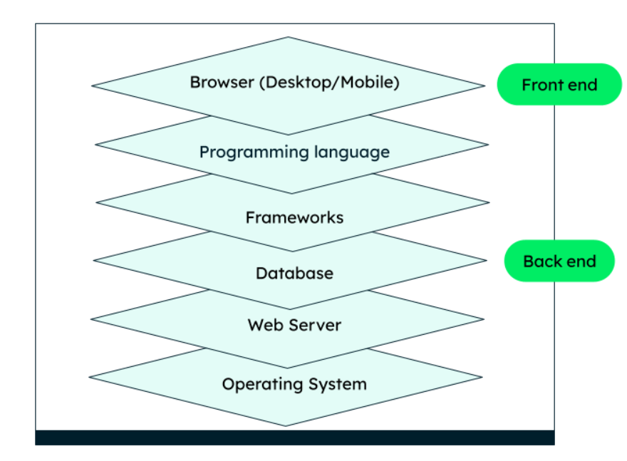
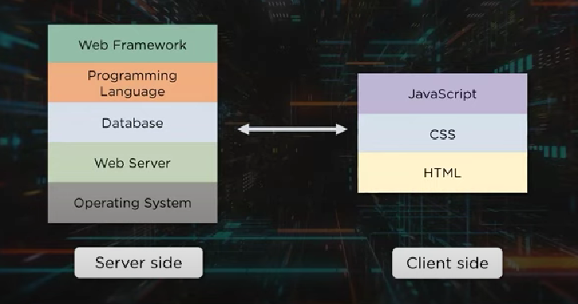
Technology Stack
By a technology stack, we refer to a combination of compatible technologies and programming languages to build an application

Slide 59

MEAN STACK
Collection of Javascript technologies that can assist in building complex websites or webapps
Abbreviation of
Notes:
To store data in JSON in backend applications + backend application runs on nodeJS + frontend framework that runs the code on the browser + provides runtime system for Javascript on the backend web applications

Slide 60
MEAN Stack
Framework with more popular plug-ins
Reduces the system administration
Better choice for Faster web and mobile app development

Slide 61
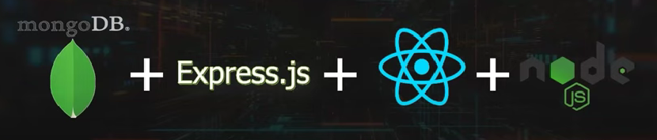
MERN STACK
Similar to MEAN Stack
Uses React Js instead of Angular JS framework
Smooth Web Development process and popular one
Notes:
React Js – javascript lib for creating UI components for web application

Slide 62
MEAN Vs MERN
Angular – React Js
JS framework – opensource Java Script Library
Uses Typescript Language – Uses javascript and JSX
Flow of data is bidirectional – unidirectional
Has a better learning curve – offers excellent documentation
Notes:
JSX- Javascript and html
Bidirectional – any changes done in view part is reflected in model part as well
Unidirectional – the model state is updated and rendered to the view part of the application

Slide 63
Which one to use?
Both stacks provide an incredible user experience.
Enterprise level projects prefer MEAN
MERN stack for smaller applications

Slide 64
Other stacks?
MEVN Stack:
Vue.js
LAMP Stack:
Linux: Operating system.
Apache: Web server.
MySQL: Relational database management system.
PHP: Server-side scripting language.
Ruby on Rails Stack (or Rails Stack):
Ruby: Programming language.
Ruby on Rails (Rails): Web application framework.
JavaScript: Client-side scripting language.
PostgreSQL: Relational database management system.

Slide 65
Flask Stack (Python):
Python: Programming language.
Flask: Web application framework.
JavaScript: Client-side scripting language.
SQLAlchemy: SQL toolkit and Object-Relational Mapping (ORM).
ASP.NET Stack:
Windows: Operating system.
Internet Information Services (IIS): Web server.
Microsoft SQL Server: Relational database management system.
ASP.NET: Web application framework.

Slide 66
Django Stack:
Django: Python web framework for the backend.
Django REST framework: Extension for building APIs.
HTML/CSS/JavaScript: Frontend development.
Database (e.g., PostgreSQL, MySQL): For data storage.
Spring Stack (Java):
Spring Boot: Java-based framework for backend development.
Spring MVC: Web module for building web applications.
Thymeleaf or React: Frontend templating or JavaScript library.
Database (e.g., MySQL, PostgreSQL): For data storage.

Slide 67
Flask/Vue.js Stack (Python):
Flask: Python web framework for backend.
Vue.js: Frontend JavaScript framework for building user interfaces.
SQLAlchemy: SQL toolkit and ORM for database interactions.
many more…

Slide 68
React vs Django
Django is a high-level Python web framework used for web development, while React is a JavaScript library for building user interfaces.

Slide 69
Factors | Django | React
Types of Frameworks | Python-based full-stack framework | JavaScript library for front-end development
Development of UI | It uses a template for client-side rendering | It uses declarative components for UI development
Security | Robust security | Not secure
Building UI | It uses template (MVT) | It uses component(MVC)
APIs and Data Handling | ORM handles the database operations. Best suited for data intensive projects. | React interacts with APIs; best suited for Single Page Application (SPA).
Project Suitability | Suitable for both large and small projects | Suitable for both large and small projects
Performance/ Scalability | Its organized approach provides seamless scalability for complex applications. | High-performance for UI rendering
SEO-Friendly | It provides out-of-the-box support for server-side rendering. | It requires third-party tools for SEO-friendly rendering.
Learning Curve | It is a lot easier to learn due to concise and clear syntax. | Familiarity with JavaScript can help to start.

Slide 70
Components of Assessment
Assignment1 – HTML and CSS
Assignment 2 - JS
Assignment 3 – Bootstrap, jquery, Django/ react
Assignment - Database
Lab Assessment - 15
Project evaluation – 6 M + 9M functionality = 15
Midsem – 20
Endsem - 30

